Slide 1
Week 3 - Notes
-Tanmay Jain

Slide 2
Deep Learning Intro

Slide 3
Uses
Machine Translation
Face Recognition
Recommendations

Slide 4
Deep Learning
Techniques based on NN with capability of learning complex patterns from data.
Feature engineering not needed as compared to Traditional ML.
Able to extract and differentiate more abstract features than traditional ML.

Slide 5


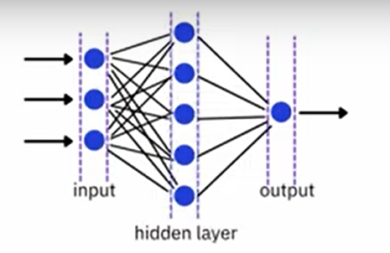

Neural Network
Algos inspired by brain
Input layer ->hidden layer(s)-> Output layer
More Hidden layers – deeper network giving name deep learning
Learning comes from ML

Slide 6
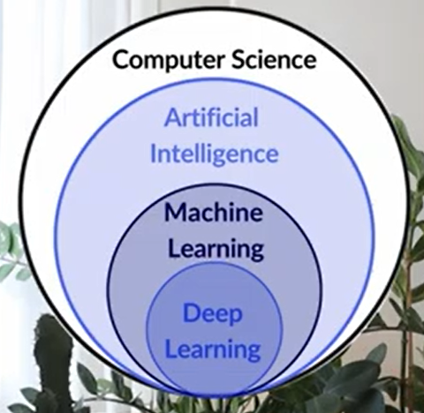

Slide 7
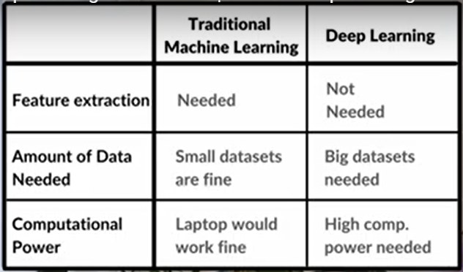

Slide 8
Neural Networks
- Universal Function Approximators (Just add more neurons!)

Slide 9
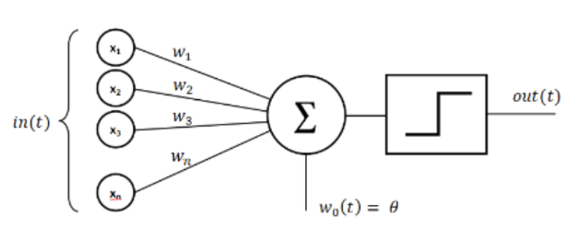
Perceptron
Initially, the technology was only linearly separable, in other words, the perceptron was only able to work with linear separation of data points which caused it to have poor recognition of different patterns.
Today, however, we have developed a method around this problem of linear separation, called activation functions.
The perceptron is a very simple model of a neural network that is used for supervised learning of binary classifiers.
A single-layer perceptron is the basic unit of a neural network. A perceptron consists of input values, weights and a bias, a weighted sum and activation function.

Slide 10
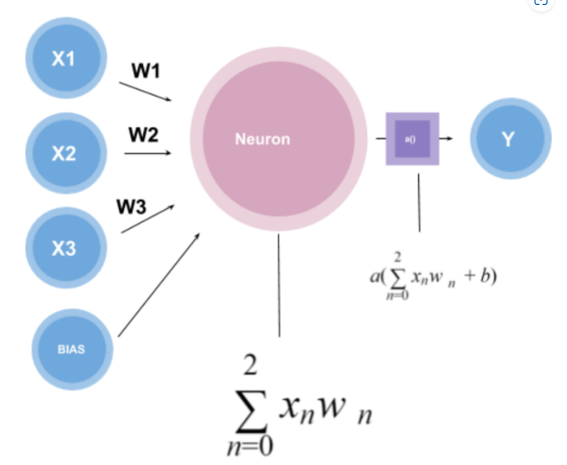
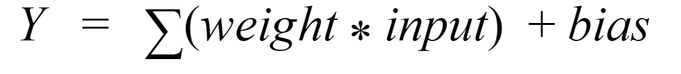
Working of Perceptron
A perceptron works by taking in some numerical inputs along with what is known as weights and a bias. It then multiplies these inputs with the respective weights(this is known as the weighted sum). These products are then added together along with the bias. The activation function takes the weighted sum and the bias as inputs and returns a final output(Y).
Y = act_func( neuron_func (inputs, weights), bias)
In general, neuron function is directly assumed to be a weighted sum.

Slide 11
Types of Activation Functions and their properties
There are different kinds of activation functions that exist, for example:
Sigmoid Function – a logistical function
Hyperbolic Tangent
ReLU Function
Softmax function
Properties:
To cater for the non-linear relationship between the input and output for a perceptron, the activation function should be non-linear.
Activation functions must be differentiable.
Should avoid or atleast minimise vanishing gradient problem.

Slide 12
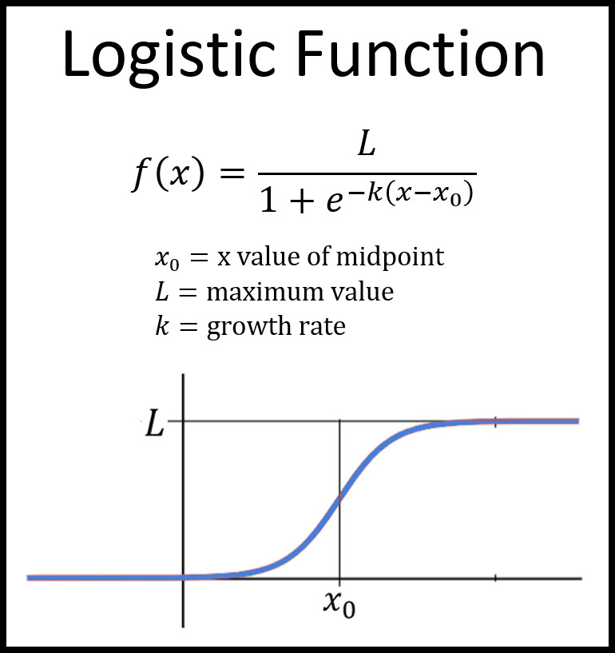
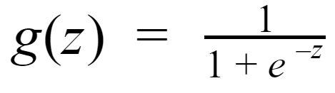
Sigmoid Function (A Logistic function)
Used to output a number from 0 - 1.
Sigmoid function have formula :
Notice that g(z) lies between the points 0 and 1 and that this graph is not linear.
This function is usually used at the last layer when we need values which are binary (0 or 1).
Problem with it is the vanishing gradient problem making training slow.

Slide 13
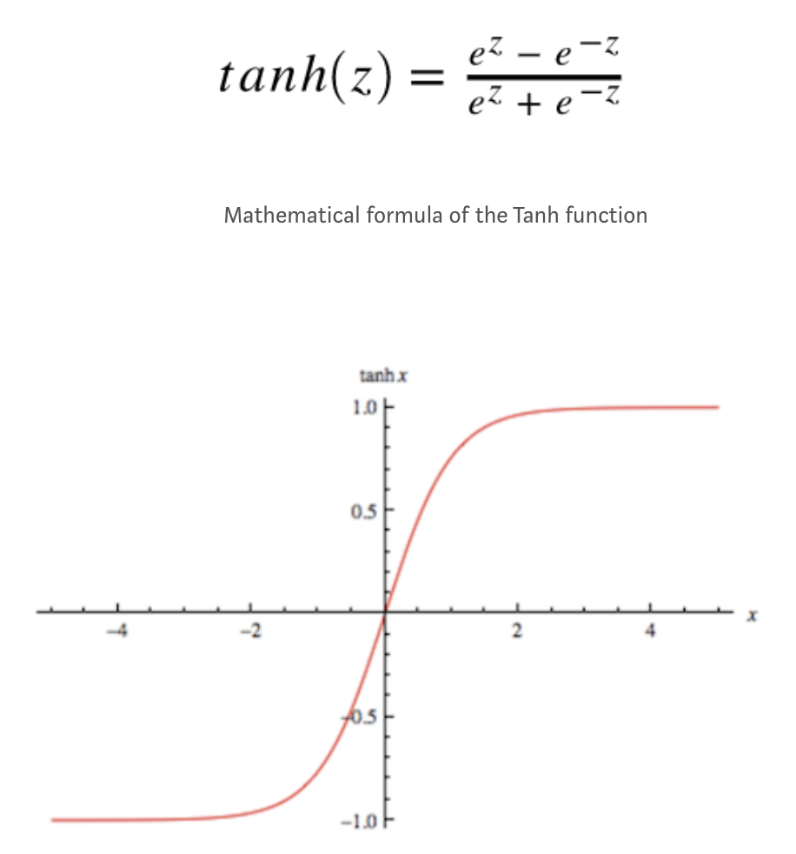
Hyperbolic Tangent
Gives a number from -1 to 1
The centering around zero helps to improve the training effect and the weight adjustments move faster in the right direction as compared to sigmoid.
Tanh function also scales smaller input values more strongly in the output range so that the values can be better separated from each other.
Used in recurrent neural networks as by using positive and negative values, the state changes in an RNN can be represented much more precisely.

Slide 14
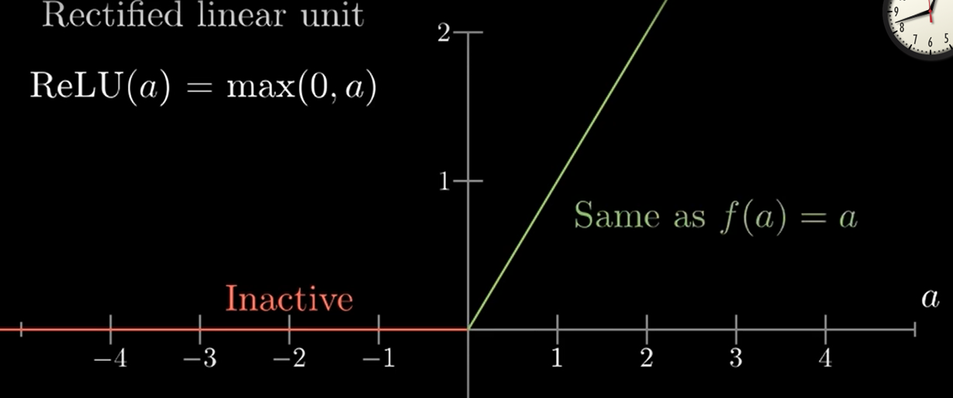
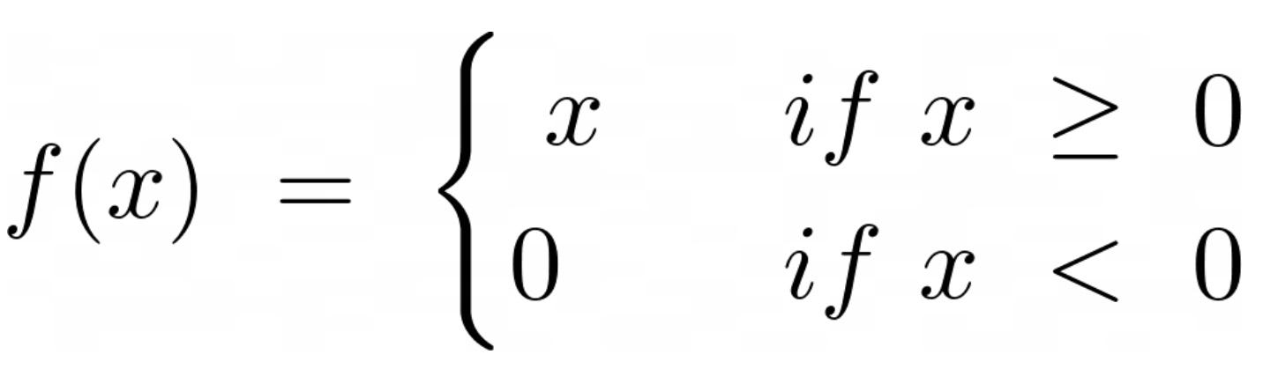
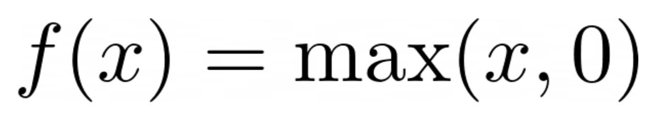
ReLU Function(widely used)
Advantages:
Solves the vanishing gradient problem.
Easier to train than sigmoid due to simple calculations because many neurons become dead when their value becomes 0.
ReLU’s ability to introduce non-linearity while remaining computationally efficient makes it the default choice in modern deep learning architectures.
Disadvantages:
Not many neurons should die off and reducing the learning capability of the network. Therefore, learning rate is to be well chosen for neurons not to die off.
It is not bounded.
- Used in autoencoders which require exact zeros.

Slide 15
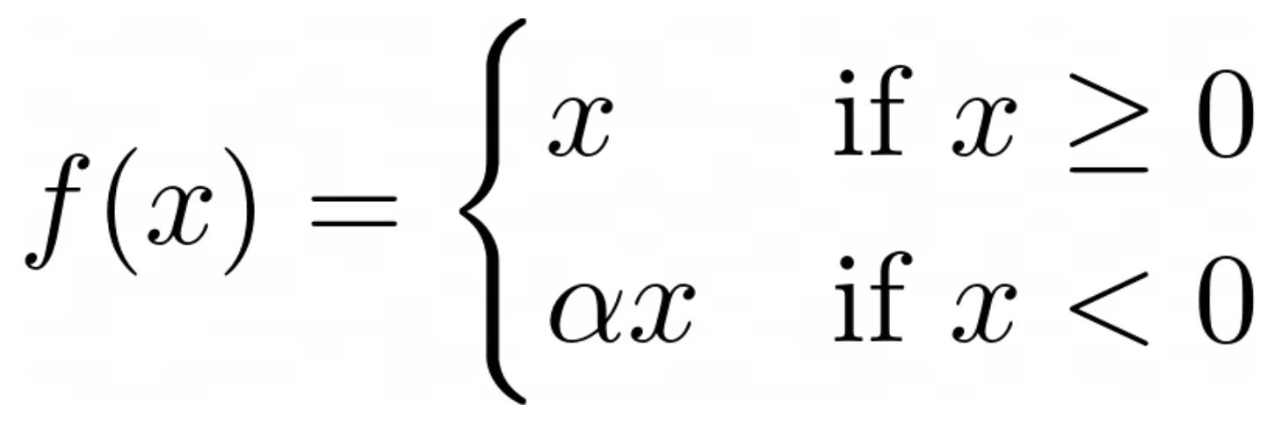
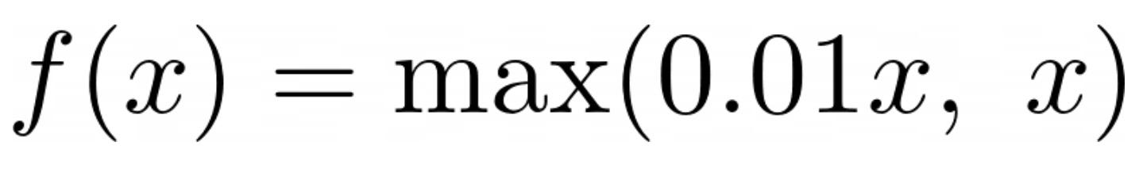
Leaky ReLU Function
The parameter α is a positive constant that must be determined before training and can be 0.01, for example.
Advantages:
Avoids the "Dying Neurons" Problem
Better Gradient Flow: Since negative values are not completely zeroed out
Faster learning with similar efficiency than ReLU.
Some datasets contain important negative values that standard ReLU ignores
Disadvantage:
A possible disadvantage is that α introduces another hyperparameter, which must be determined before training and has a major influence on the quality of the training. A value that is too small can slow down learning, as some neurons do not die, but come close to zero and therefore contribute little to training.

Slide 16
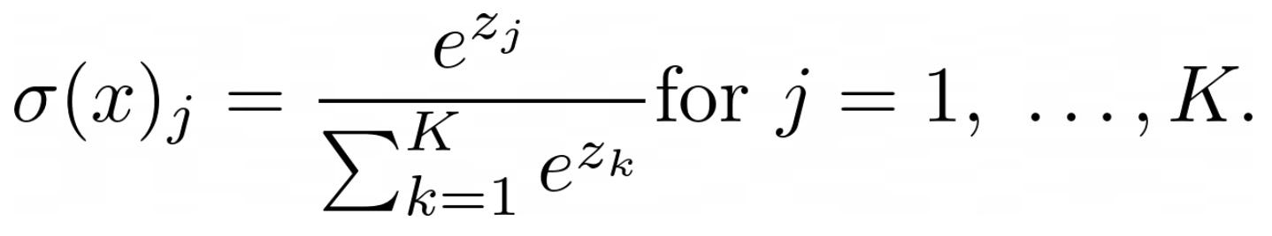
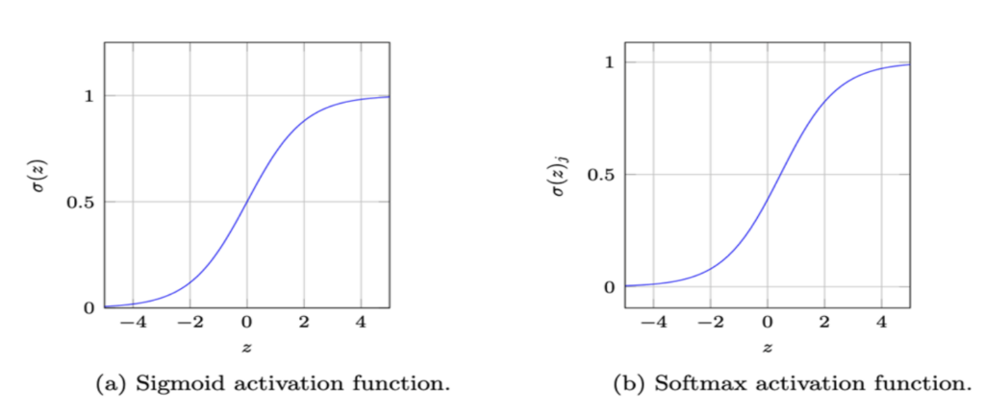
Softmax Function
Advantages:
Ensures that the sum of the output values is always less than or equal to 1.
used for classifications that are to predict more than two classes, whereas sigmoid function can be used only for binary classifications.
outputs represent probabilities, which are particularly helpful in classification problems
Disadvantages:
predictions are overconfident even though the model is quite uncertain. Therefore, measures for uncertainty assessment should be included to avoid this problem
Softmax is suitable for multi-class classifications, the number of classes should not increase too much, as the exponential calculation for each class would then be too high. Also, the model may then become unstable as the probabilities for individual classes become too low

Slide 17
Choosing the right Activation Function
In the hidden layers, the activation function ReLU and its variants to avoid vanishing gradient problem, cater non-linear relationships and for efficiency.
Output layers - Softmax and Sigmoid, for example, are suitable for classification problems
Linear activation functions are suitable for output layers that are to map a linear regression problem.

Slide 18
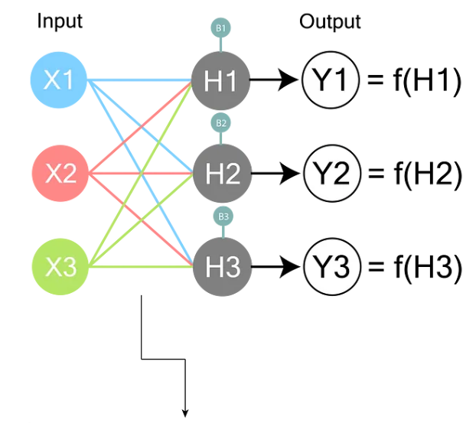
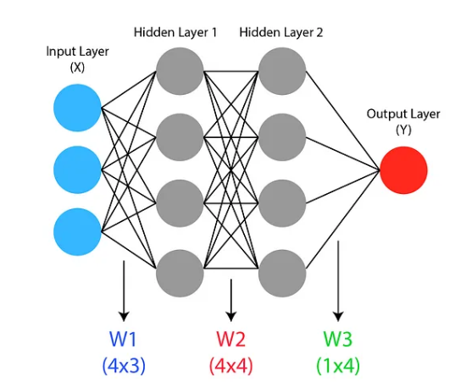
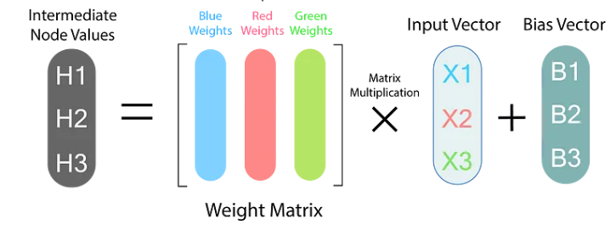
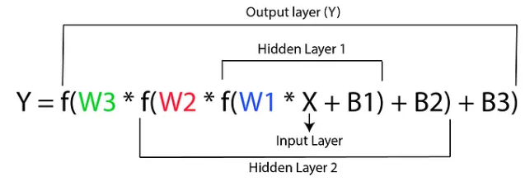

Slide 19
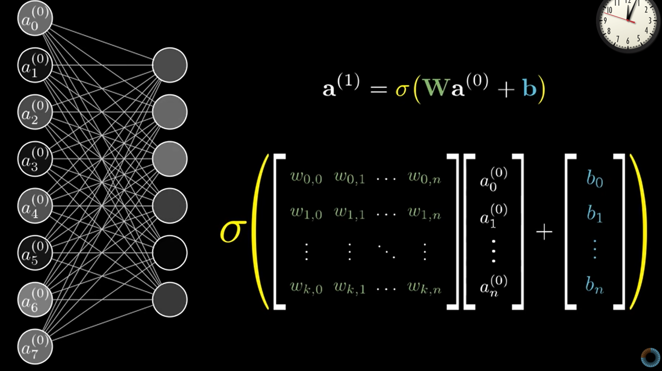
How Neural Networks work?
The weight set of each perceptron is a unique vector.
The set of all such vectors corresponding to the perceptrons in a layer, form a weight matrix(W, an M*N weight matrix means that it is between two layers with the first layer having N nodes and the second layer having M nodes) which when multiplied by the input vector(a⁽⁰⁾) for the given layer(perceptron outputs values of previous layer) and added to the bias vector(b – a weight vector without an input term useful for having an extra bit of adjustability which is not dependant on previous layer) of the layer gives the perceptron values of the current layer(a⁽¹⁾ = input values for the next layer).
Therefore, the whole neural network turns out to be a linear function of input vector, weight matrices and bias vectors.
Training a neural network for a task means finding the correct set of weight matrices and bias vectors for it.
Except the neurons of input layer each neuron is a part of a perceptron which serves as a function taking set values of all neurons of the previous layer(depends on input) and the set of their connection weights(fixed for a NN trained for a particular task) as parameters.

Slide 20
Advantage of NN over direct programming
We cant directly device algorithms for all complex data sets and write code for it. So we use NNs there where the NN learns the pattern itself by looping over the data several times and modifying its structure wrt it.
No need to understand the underlying pattern. The NN just learns it.

Slide 21
Methods of Training NNs
Back Propagation is one of the methods to train a particular type of NNs called Feed Forward NN(we have so far seen one type of FFNN called Multilayer Perceptron) using the principle of gradient descent.
Note: It is easier to train NNs with correctly labeled data sets than randomly labeled data sets showing that the NN not just memorize but identify patterns which becomes difficult with random data.

Slide 22
Gradient Descent
Cost of training example – sum of sq. of diff. b/n labels and actual outputs
Cost function is avg cost for all training data.
We minimise the cost function to train a NN – finding the downhill direction for a multi dimensional graph.(-grad F)
Gradient vector encodes the relative importance of each weight in the magnitude of its components.
Algorithm:
Find: –grad F
Step in its direction with a step size proportional to its magnitude.
Repeat until step size reaches some error limit.

Slide 23
Back Propagation
Neurons that fire together wire together.
Explanation of algorithm:
Take labeled sample with initial random weights and compute the value of all neurons.
Consider the changes needed on each neuron in the output layer to coincide it with the labels, with magnitude and sign.
For example if we want to increase a neuron value in output layer we can do it by:
Increasing bias values
Increasing and decreasing the brightness of neurons with +ve and –ve weights respectively proportional to magnitude of weights(which cant be done directly but by controlling the previous layer). Compute relative change vector for pervious layer wrt all output neurons in the current training example i.e. corresponding to the random set of weights of each output neuron. Sum of all these vectors gives the net relative change vector for second last layer. This would help to compute change in weights and biases between previous layers.
Increasing weights between previous and output layer proportional to brightness of previous layer. Compute the relative change vector for all weights and for all training examples and average out to get net change vector which is proportional to –grad(cost function).
Algorithm to minimize gradient
The minimized gradient value depends on all sample input sets
Training takes time so the training set is divided into batches which gives small error in computing grad but speeds up training – Stochastic Gradient Descent.
Training requires large labeled data sets – MNIST Database for digits

Slide 24
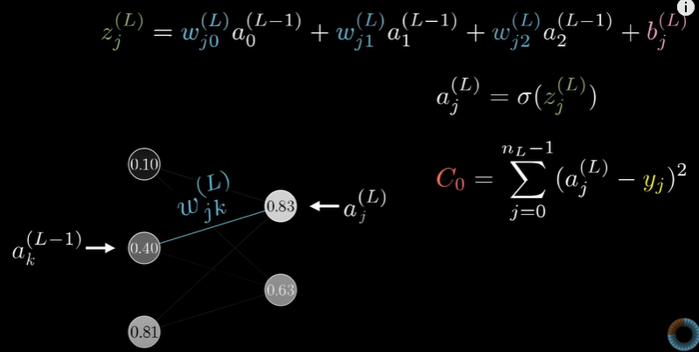
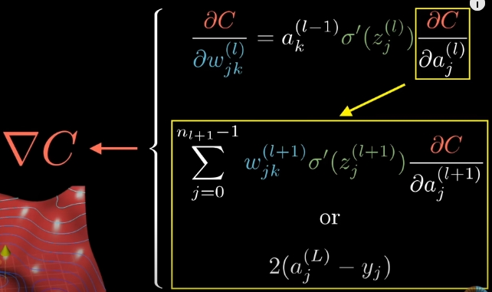
Calculus Behind Back Propagation
j = indexing of neurons of current layer
k = indexing of neurons of previous layer
l = layer number
C = cost function
a = neuron value
z = weighted sum
n_{L} = number of neurons in Lth layer.

Slide 25
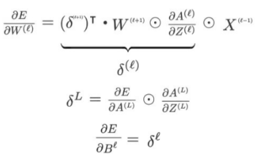

Slide 26
Thank You

